Slide 1
Python is Compiled!
(And How to Analyze its Bytecode)

Slide 2
Hi! I’m Ivy
they/them - 2A SYDE CS
A.K.A hexadecimal_dinosaur
Forensics + RevEng @ sillysec (https://cve.gay/)
Stores too much malware on their computer

Slide 3
Python is Compiled?
Compiled
Interpreted
Source code is converted into a binary with a compiler and linker
C/C++
Rust
Go
Haskell
Code is parsed and executed line-by-line by an interpreter
Bash
PowerShell
JavaScript
Perl

Slide 4
Bytecode Languages
Binary Compiled
Interpreted
Bytecode Compiled
C/C++
Rust
Go
Haskell
Java (to .class files)
Python (to .pyc files)
Bash
PowerShell
JavaScript
Perl

Slide 5
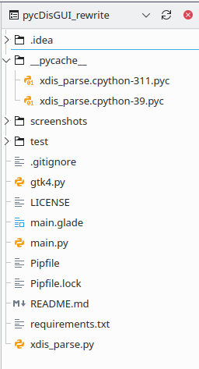
.pyc Files
Compiled at runtime
Contains Python code objects
Cached in the __pycache__ folder

Slide 6
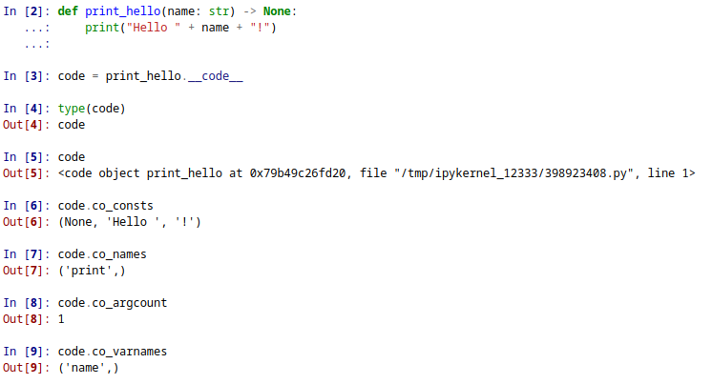
Notes:
Source code is compiled to code objects that contain python bytecode and other details about the code at runtime

Slide 7
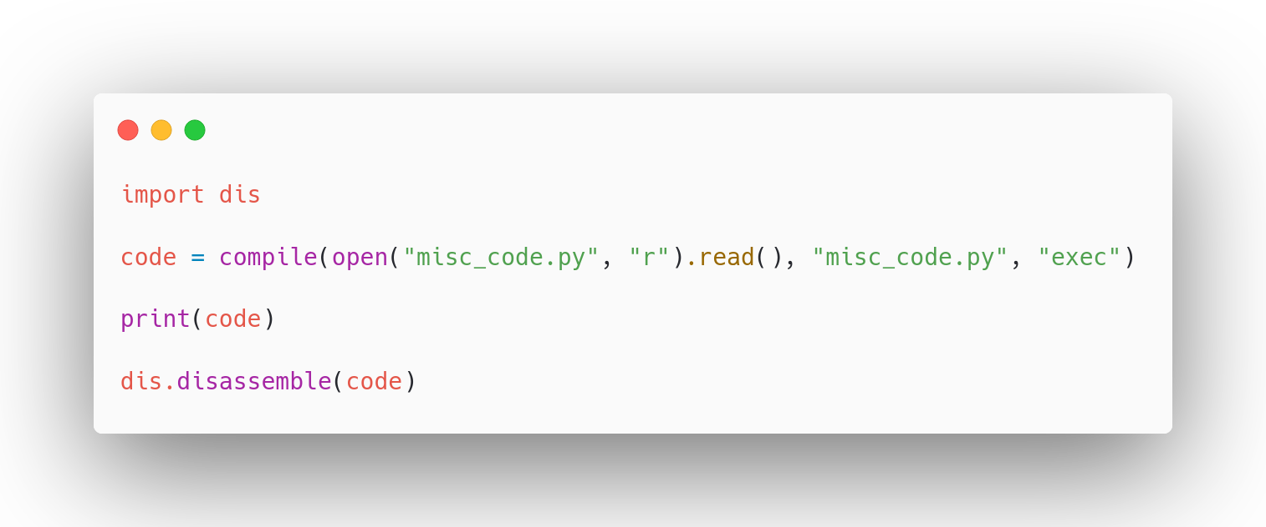
Notes:
Can compile source code using the builtin compile method or the compileall module

Slide 8
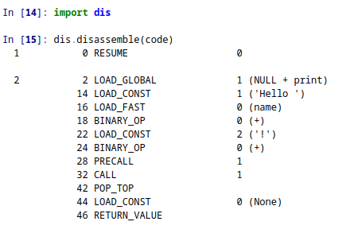
Python Bytecode
Notes:
Runs in the Python Virtual Machine
Is Stack Based

Slide 9
Stack Based Instruction Set?
2 2 LOAD_GLOBAL 1 (NULL + print)
14 LOAD_CONST 1 ('Hello ')
16 LOAD_FAST 0 (name)
18 BINARY_OP 0 (+)
22 LOAD_CONST 2 ('!')
24 BINARY_OP 0 (+)
28 PRECALL 1
32 CALL 1
42 POP_TOP
44 LOAD_CONST 0 (None)
46 RETURN_VALUE

Slide 10
Stack Based Instruction Set?
2 2 LOAD_GLOBAL 1 (NULL + print)
14 LOAD_CONST 1 ('Hello ')
16 LOAD_FAST 0 (name)
18 BINARY_OP 0 (+)
22 LOAD_CONST 2 ('!')
24 BINARY_OP 0 (+)
28 PRECALL 1
32 CALL 1
42 POP_TOP
44 LOAD_CONST 0 (None)
46 RETURN_VALUE
print function

Slide 11
Stack Based Instruction Set?
2 2 LOAD_GLOBAL 1 (NULL + print)
14 LOAD_CONST 1 ('Hello ')
16 LOAD_FAST 0 (name)
18 BINARY_OP 0 (+)
22 LOAD_CONST 2 ('!')
24 BINARY_OP 0 (+)
28 PRECALL 1
32 CALL 1
42 POP_TOP
44 LOAD_CONST 0 (None)
46 RETURN_VALUE
‘Hello ’
print function

Slide 12
Stack Based Instruction Set?
2 2 LOAD_GLOBAL 1 (NULL + print)
14 LOAD_CONST 1 ('Hello ')
16 LOAD_FAST 0 (name)
18 BINARY_OP 0 (+)
22 LOAD_CONST 2 ('!')
24 BINARY_OP 0 (+)
28 PRECALL 1
32 CALL 1
42 POP_TOP
44 LOAD_CONST 0 (None)
46 RETURN_VALUE
name variable
‘Hello ’
print function

Slide 13
Stack Based Instruction Set?
2 2 LOAD_GLOBAL 1 (NULL + print)
14 LOAD_CONST 1 ('Hello ')
16 LOAD_FAST 0 (name)
18 BINARY_OP 0 (+)
22 LOAD_CONST 2 ('!')
24 BINARY_OP 0 (+)
28 PRECALL 1
32 CALL 1
42 POP_TOP
44 LOAD_CONST 0 (None)
46 RETURN_VALUE
‘Hello ’ + name
print function

Slide 14
Stack Based Instruction Set?
2 2 LOAD_GLOBAL 1 (NULL + print)
14 LOAD_CONST 1 ('Hello ')
16 LOAD_FAST 0 (name)
18 BINARY_OP 0 (+)
22 LOAD_CONST 2 ('!')
24 BINARY_OP 0 (+)
28 PRECALL 1
32 CALL 1
42 POP_TOP
44 LOAD_CONST 0 (None)
46 RETURN_VALUE
‘!’
‘Hello ’ + name
print function

Slide 15
Stack Based Instruction Set?
2 2 LOAD_GLOBAL 1 (NULL + print)
14 LOAD_CONST 1 ('Hello ')
16 LOAD_FAST 0 (name)
18 BINARY_OP 0 (+)
22 LOAD_CONST 2 ('!')
24 BINARY_OP 0 (+)
28 PRECALL 1
32 CALL 1
42 POP_TOP
44 LOAD_CONST 0 (None)
46 RETURN_VALUE
‘Hello ’ + name+ ‘!’
print function

Slide 16
Stack Based Instruction Set?
2 2 LOAD_GLOBAL 1 (NULL + print)
14 LOAD_CONST 1 ('Hello ')
16 LOAD_FAST 0 (name)
18 BINARY_OP 0 (+)
22 LOAD_CONST 2 ('!')
24 BINARY_OP 0 (+)
28 PRECALL 1
32 CALL 1
42 POP_TOP
44 LOAD_CONST 0 (None)
46 RETURN_VALUE
None (returned from print)
print(“Hello ” + name + “!”)

Slide 17
Demo???

Slide 18
How is this useful?

Slide 19
Resources
Python dis module documentation - https://docs.python.org/3/library/dis.html
Inside the Python Virtual Machine (Obi Ike-Nwosu) - https://leanpub.com/insidethepythonvirtualmachine/read
Python’s Innards (Yaniv Aknin) - https://tech.blog.aknin.name/category/my-projects/pythons-innards/
Is Python interpreted or compiled? Yes. (Ned Batchelder) - https://nedbatchelder.com/blog/201803/is_python_interpreted_or_compiled_yes.html
xdis Python disassembler - https://github.com/rocky/python-xdis

